Slide 1


Social Buzz
Accenture
Presented by: Bill Kamanzi - Data Analyst

Slide 2


Today's agenda
Project recap
Problem
The Analytics team
Process
Insights
Summary

Slide 3

Social Buzz is a rapidly expanding tech company facing the challenges of scaling globally. To support their growth, Accenture is conducting a 3-month proof of concept (POC) focused on the following key areas:
Big Data Audit: Reviewing Social Buzz’s current data management practices to enhance efficiency and scalability.
IPO Readiness: Providing strategic recommendations to ensure a smooth and successful IPO.
Content Analysis: Analyzing the top 5 content categories to identify key trends and guide future decisions.
Project Recap

Slide 4

Problem
With over 100,000 pieces of content posted daily, Social Buzz generates a staggering 365.5 million posts each year. Managing and capitalizing on such vast amounts of data is a major challenge. The key question is: How can Social Buzz leverage this content to drive engagement and growth?
Our analysis focuses on identifying the top 5 content categories with the highest engagement to guide strategic decisions and optimize content delivery.

Slide 5



Chief Technology Architect
Andrew Fleming
Overseeing the technical architecture and data audit.
The Analytics team
Senior Principal
Marcus Rompton
Leading the business advisory for IPO readiness
Data Analyst
Bill Kamanzi
Responsible for data analysis and visualization.

Slide 6
Process
1
Data Understanding
2
Data Cleaning
3
Data Modeling
4
Data Analysis
5
Uncover Insights

Slide 7

Insights
16
Animal
May
Unique Categories
Most Popular Category
Most Number of Posts

Slide 8
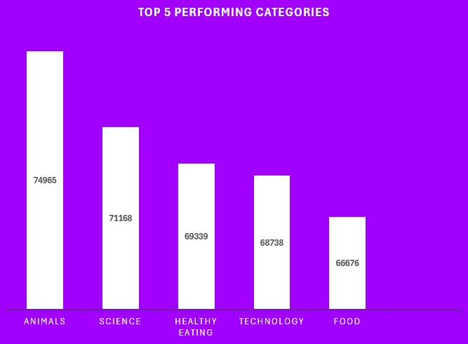

Slide 9
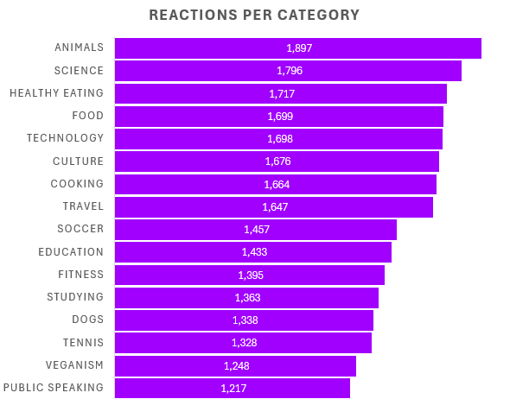

Slide 10
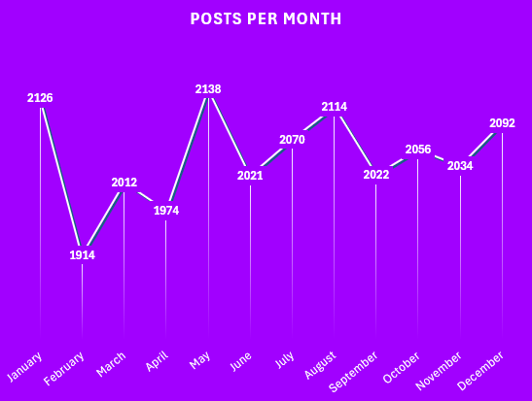

Slide 11

ANALYSIS & INSIGHTS:
With 16 Unique Content Categories, the Animal, Science, Healthy Eating, Technology, and Food categories were the most popular and performing categories.
They additionally had the most positive reactions hence why they had the highest scores.
The month of May had the most posts, followed with a steady small decline towards the end of the year.
With these insights, you can create a campaign and work with brands in the science, healthy eating, and tech domains to boost user engagement.
Summary

Slide 12
Thank you!
ANY QUESTIONS?

